Slide 1
Lecture 12: Message Authentication
An Introduction to Information Security
School of Big Data and Software Engineering, CQU
Fall, 2018

Slide 2
Quickly Review
Lecture 11
Number Theory
RSA: How to generate Key pairs
RSA: Encryption and Decryption
1. Choose two (large) prime number p, q privately
2. Calculate
3. Choose e with
4. Calculate
5. Publicize {e,n} and keep d private

Slide 3
Public-key cipher vs. Symmetric key cipher
From its earliest beginning to modern times, virtually(事实上) all cryptographic systems have been based on the elementary tools of substitution and permutation.
Public-key algorithms are based on mathematical functions rather than on substitution and permutation.
Public-key cipher can be used for
encryption/decryption
digital signature
key exchange/management
Some common misconceptions(误解) about PKC should be mentioned:
PKC is more secure than symmetric key encryption
PKC is a general-purpose technique
key distribution is trivial(没有意义) when using PKE

Slide 4




对称密钥加密—保密通信
symmetric-key cipher：en/decryption with the same session key Ks.
Alice
Bob
Plaintext
Plaintext
AES
Secure Key-exchange Channel
Decryption Algorithm
Ks
Ks
Ciphertext
Ciphertext
Insecure Channel

Slide 5
非对称密钥加密—保密通信（传递会话密钥）
symmetric-key cipher(AES)：en/decryption with the same session key Ks.
Use asymmetric-key cipher (RSA) to deliver session key Ks .
Alice
Bob
Plaintext
Plaintext
Ku_{B}
Kr_{B}
AES
Ks
RSA
RSA
Ks
AES
Ciphertext
Ciphertext
Insecure Channel

Slide 6

Contents
1.Review of Security Services
2.Message Authentication
3.Message Authentication Code
4.Cryptographic Hash Function

Slide 7


Quickly Review
Story
信陵君窃符救赵

Slide 8
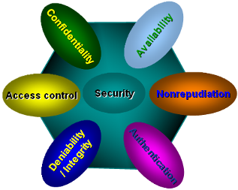
1.Review of Security Services
Authorization
audit
encipherment
Information Hiding
digital signatures
recovery
access controls
notarization
traffic padding
backup
Watermarking
Identification
password
filtration
Biometrics
Requirements
Implementation
from Security Service to Security Mechanism

Slide 9
1.Review of Security Services
INFORMATION ATTACK/ SECURITY CONCERNS
Five information attack/security concerns have been raised so far:
Disclosure(泄密)
Traffic analysis
Masquerade(冒充)
Modification(篡改)
Content modification
Sequence modification
Timing modification
Repudiation(推诿)

Slide 10
1.Review of Security Services
SOLUTIONS FOR THESE CONCERNS
Message
confidentiality
Disclosure
Traffic analysis
Digital
signature
Repudiation
Message
authentication
Masquerade
Modification

Slide 11
Contents
1.Review of Security Services
2.Message Authentication
3.Message Authentication Code
4.Cryptographic Hash Function

Slide 12
2.Message Authentication
Definition
Message authentication is a procedure to verify that received messages come from the alleged(声称的) source and have not been changed.
Examples?
Digital signature is one of the message authentication mechanisms

Slide 13
2.Message Authentication
LEVELS OF MESSAGE AUTHENTICATION
Two fundamental levels of message authentication
mechanisms are deployed(部署):
Lower-level: Authenticator
Message encryption
基础
Message authentication code (MAC)
Hash function
Higher-level: Authentication protocols
应用
PGP( Pretty Good Privacy)
Kerberos

Slide 14
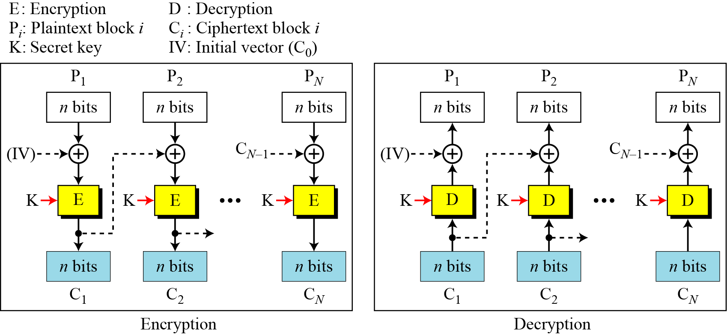
2.Message Authentication
MESSAGE ENCRYPTION
For symmetric encryptions, they provide
Confidentiality
Message authentication,
e.g. CBC mode

Slide 15
2.Message Authentication
MESSAGE ENCRYPTION
For Public-key encryptions, they provide:
Message Authentication,
The sender encrypts the message using his/her private key, which provides the digital signature
Confidentiality
The sender uses the receiver’s public key to encrypt the encrypted message again, which provides the confidentiality
How many encryption/decryption
Processes this algorithm has to exercises?

Slide 16
Contents
1.Review of Security Services
2.Message Authentication
3.Message Authentication Code
4.Cryptographic Hash Function

Slide 17
3.Message Authentication Code
Message Authentication Code
Why don’t we just generate a small fixed-size block of data, which is known as message authentication code (MAC), and append it to the message?
A and B share a common secret key
Suppose that A sends a message M to B
A first calculates the MAC as a function of the
message and the key:
The message plus MAC are sent to B
Once received the message, B performs the same
calculation to generate a new MAC:
if
the message is authenticated

Slide 18
3.Message Authentication Code
A SIMPLIFIED MAC MODE
I
N
T
E
R
N
E
T
M
M
M
MAC’
MAC’
MAC
MAC
MAC
MAC

Slide 19
3.Message Authentication Code
The Difference between MAC and Encryption
A MAC function is similar to encryption in the sense that
both sender and receiver share a common key
They are different in the sense that
the MAC function is not necessary to be reversible(可逆)
REMARK
A MAC function does not provide a digital signature mechanism
Why

Slide 20
Contents
1.Review of Security Services
2.Message Authentication
3.Message Authentication Code
4.Cryptographic Hash Function

Slide 21
4.Cryptographic Hash Function
HASH FUNCTION
A hash function accepts
a variable-size message M as input
produces a fixed-size hash code H(M) as output
Why we need hash functions when we already have DES, AES RSA, … ?

Slide 22
4.Cryptographic Hash Function
THE REASONS FOR USING HASH FUNCTION
encryption software is quite slow
encryption hardware costs are not negligible
encryption hardware is optimized toward large data sizes
encryption algorithms may be covered by patents(专利).
encryption algorithms are subject to U.S. export control

Slide 23
4.Cryptographic Hash Function
REQUIREMENTS FOR HASH FUNCTIONS
1. H(x) can be applied to a block of data x of any size
2. H(x) produces a fixed-length output
3. H(x) is relatively easy to compute for any given x,
making both hardware and software implementations practical
4. One-way property: For any given code h, it is computationally
infeasible to find x such that H(x) = h.
5. Weak collision resistance: For any given block x,
it is computationally infeasible to find
with H(y) = H(x)
6. Strong collision resistance: It is computationally infeasible to
find any pair (x, y) such that H(x) = H(y)

Slide 24
4.Cryptographic Hash Function
A SIMPLE HASH FUNCTION
One of the simplest hash functions is the bit-by-bit XOR of every block:
Block 1
b11 | b21 | … | bn1
b12 | b22 | … | bn2
. . . | . . . | . . . | . . .
bm1 | bm2 | … | bnm
C1 | C2 | … | Cn
Block 2
Block m
Hash
code

Slide 25
4.Cryptographic Hash Function
PRINCIPLES OF HASH FUNCTION
The hash algorithm involves repeated use of a compression function f
takes two inputs
chaining variable: n-bit input from the previous step
a b-bit block
produces an n-bit output

Slide 26

4.Cryptographic Hash Function
MD5 MESSAGE DIGEST ALGORITHM
The MD5 message digest algorithm was created
by Ron Rivest at MIT in 1990
It takes as input a message of arbitrary length
(but blocking them 512-bit each) and produces
as output a 128-bit message digest
最
终
的
消
息
文
摘

Slide 27
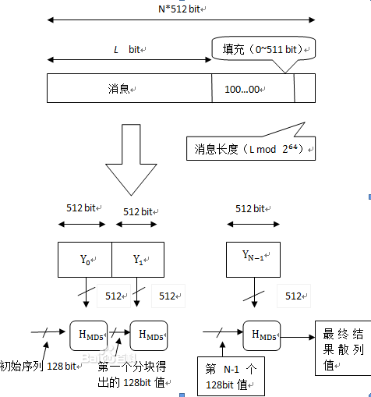
4.Cryptographic Hash Function
Whole Picture of MD5

Slide 28
4.Cryptographic Hash Function
Process of MD5
The process of MD5 consists of 5 phases:
Phase 1. Append padding bits:
The message is padded so that its length in bits is
Phase 2. Append length
A 64-bit representation of the length in bits of the original message (before padding) is appended to the result of phase 1.
第一,二阶段
结束后
The outcome of the first two phases yields
a message that is an integer multiple of 512 bits

Slide 29
4.Cryptographic Hash Function
Process of MD5
Phase 3. Initialize MD buffer
A 128-bit buffer is used to hold
intermediate results of MD5
final result of MD5
The MD buffer: The buffer is represented as four 32-bit registers (A, B, C, D), which takes initial values:
A | 67452301
B | EFCDAB89
C | 98BADCFE
D | 10325476

Slide 30
4.Cryptographic Hash Function
Process of MD5
Phase 4. Process message in 512-bit blocks:
the 512-block is processed using a complex compression function
processed in 4 rounds with different function
Round | Primitive Function | Definition
1 | F(b, c, d)
2 | G(b, c, d)
3 | H(b, c, d)
4 | I(b, c, d)

Slide 31
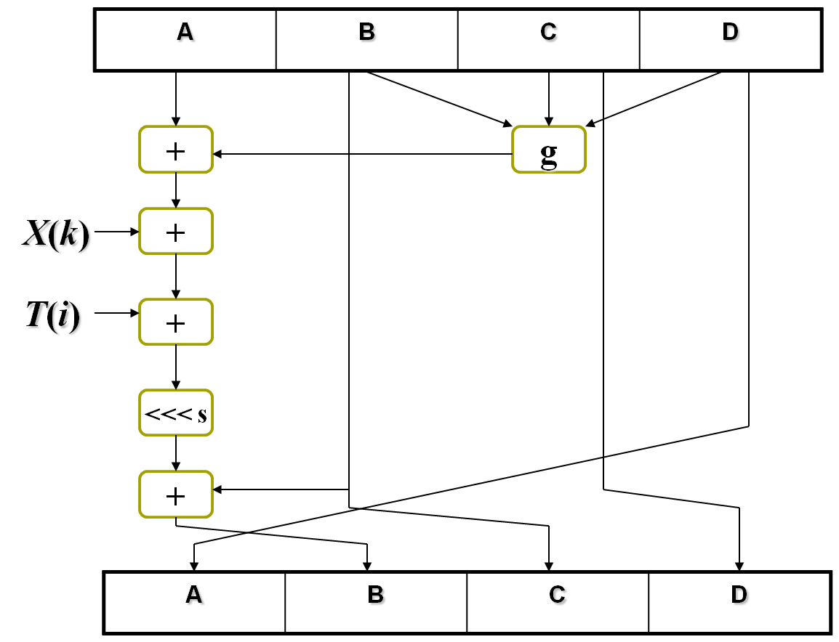
4.Cryptographic Hash Function
Y_{q} 512bit
qth block
x₁
32bit
x_{k}
x₁₆
Round 1
i：1-16
k：1-16
Round 2
i：17-32
k：1-16
Round 4
i：49-64
k：1-16

Slide 32
4.Cryptographic Hash Function
X(k)
g(b,c,d)
T(i)
Each round (I, H, G, and F) consists of
sequence of 16 steps
s
Each step is of the form
基本算式
where
g(b, c, d) is one of I, H, F, G
is the kth 32-bit word in the qth 512-bit block
of the message
s takes different values in the different rounds
For example: 7, 12, 17, 22
P262

Slide 33
4.Cryptographic Hash Function
Process of MD5
Phase 5. output 128bit digest
SUMMARY OF MD5

Slide 34
4.Cryptographic Hash Function
SHA: Secure Hash Algorithm
SHA-1 derived from MD4
SHA-2 family
SHA-224,
SHA-256,
SHA-384, and
SHA-512

Slide 35
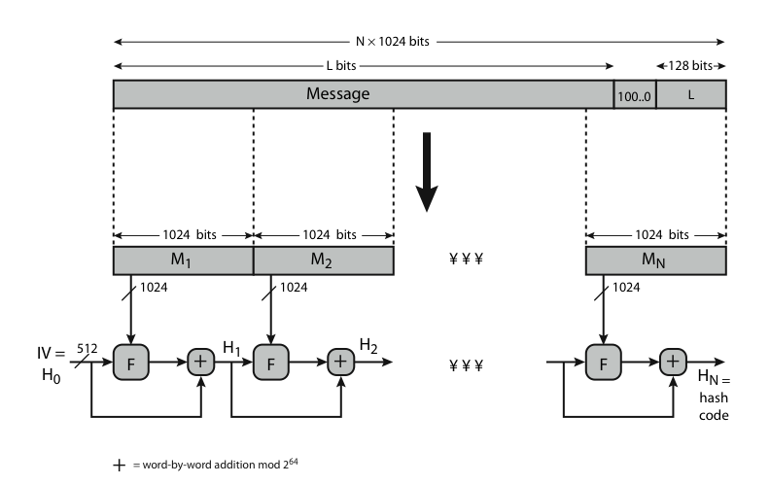
4.Cryptographic Hash Function
Overview of SHA-512

Slide 36
Lecture 10: Public Key Cryptography-RSA
Summary
Message Authentication
Message Authentication Code
Hash Function

Slide 37
An Introduction to Information Security
Thanks for your attention!
Q&A

